Slide 1


Group 01
WEATHER REPORT APP
Lecture: Nguyen Thanh Binh
Mobile Development

Slide 2
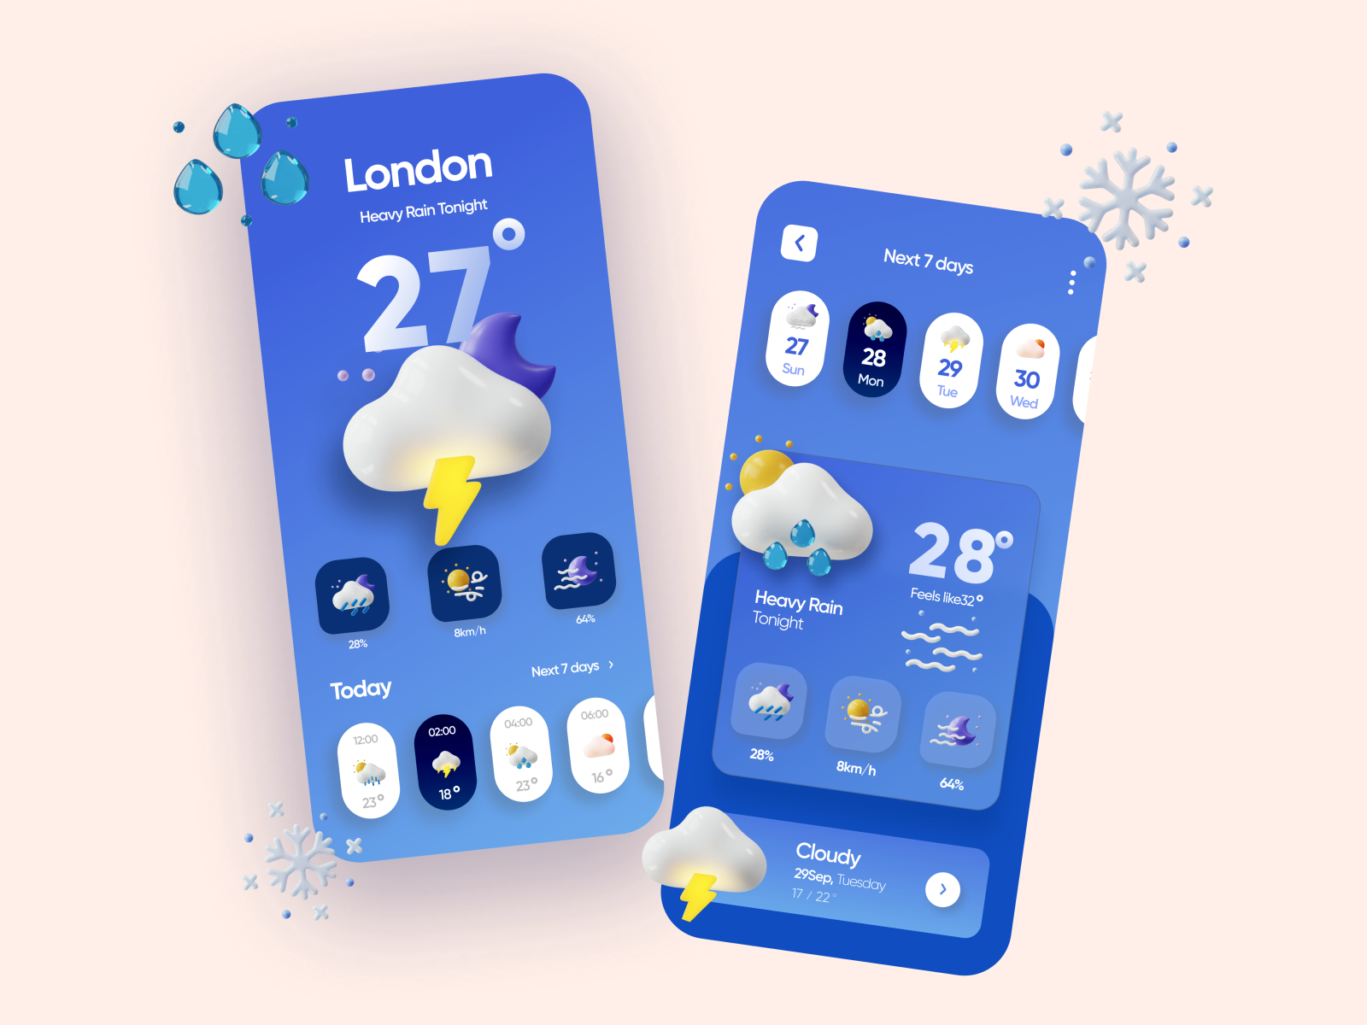



MEMBER TEAM
Dương Minh Thành
Đinh Ngọc
Sơn Anh

Slide 3
TABLE OF CONTENTS
01
02
03
04
05
Introduction
Technicals
Working Principle
BENEFITS
Demo

Slide 4
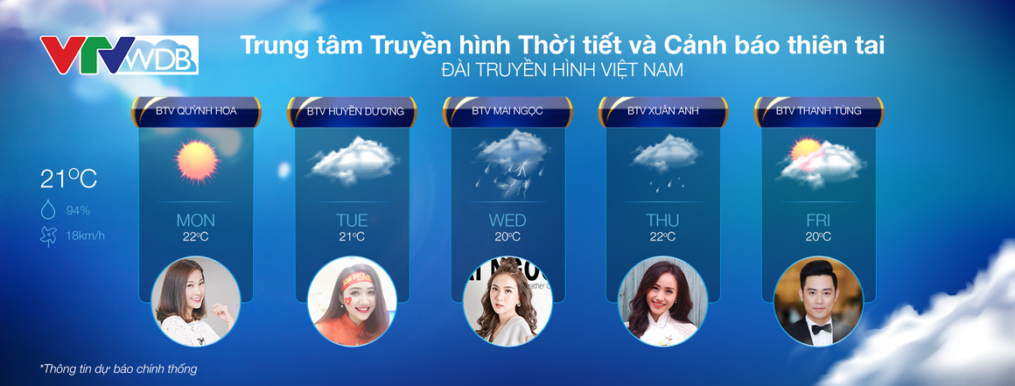
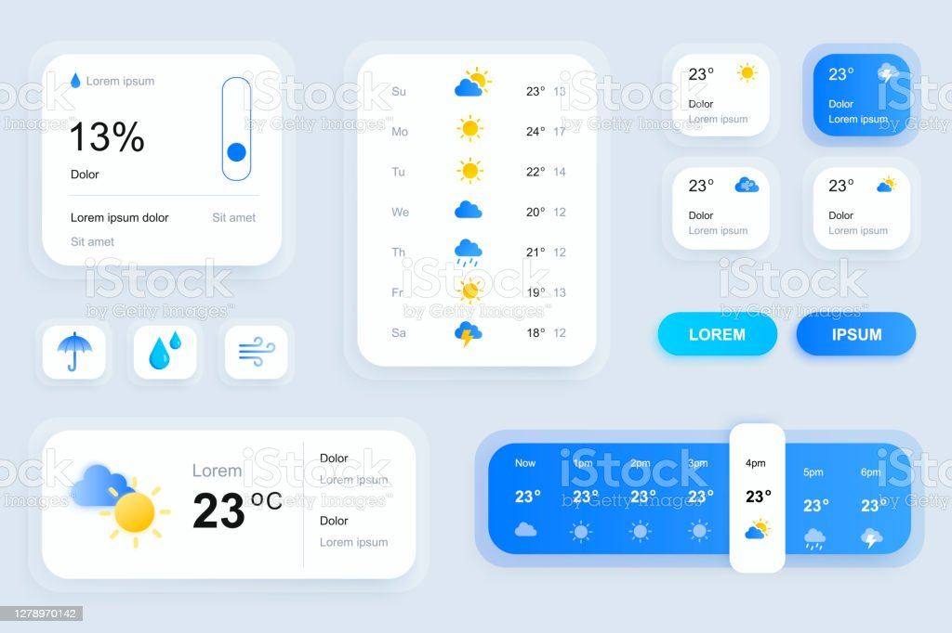

INTRODUCTION
Weather Forecast Show
Weather Report App
Mobile Development

Slide 5


TECHNICALS
Android Studio
Open Weather

Slide 6
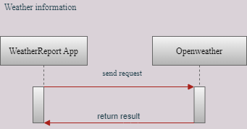
WORKING PRINCIPLE(SHOW WEATHER INFORMATION(TODAY))

Slide 7
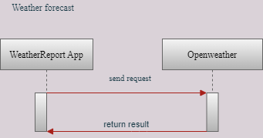
WORKING PRINCIPLE(SHOW WEATHER FORECAST(7 DAYS))

Slide 8


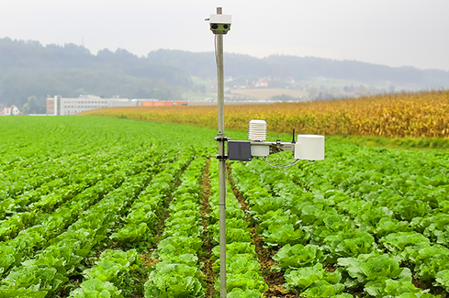
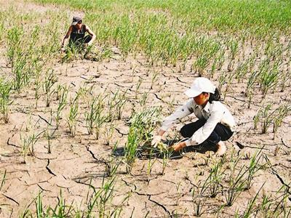
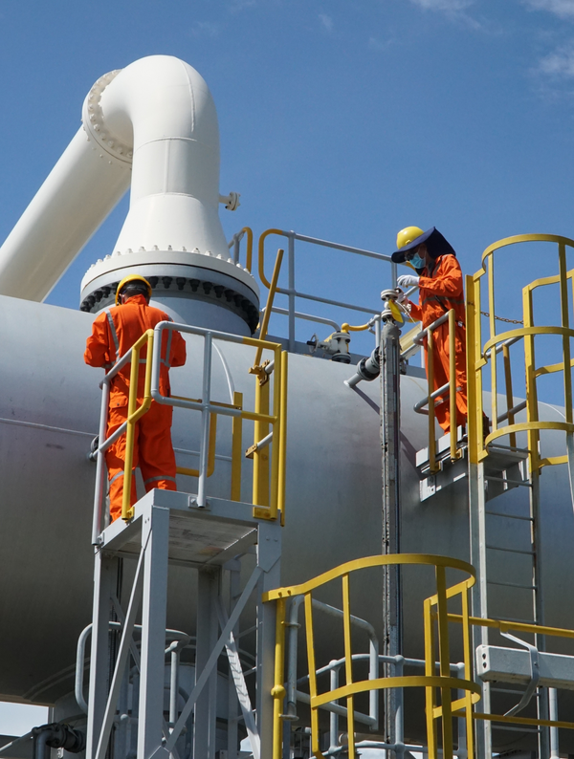
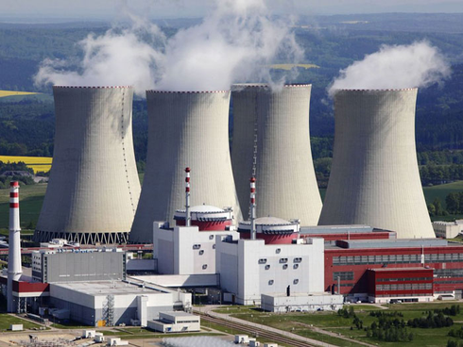

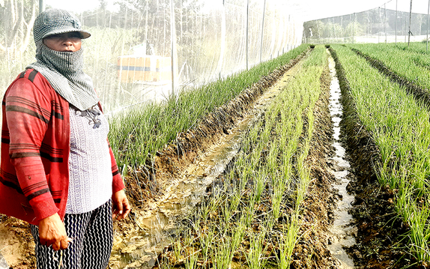
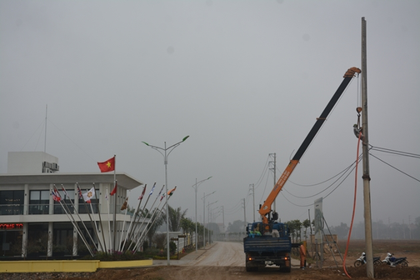
BENEFITS
In the family
In agriculture
In industry:

Slide 9
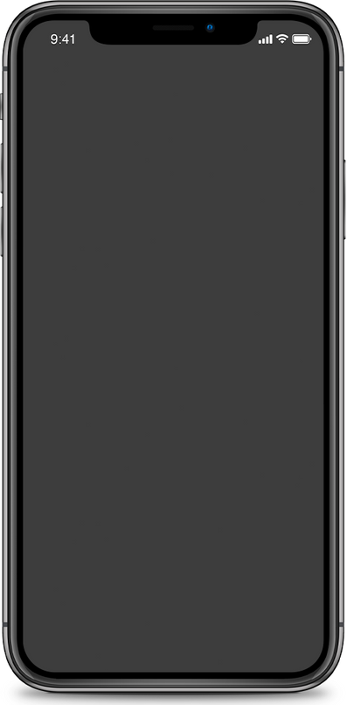
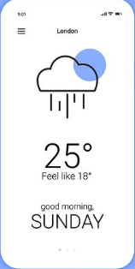
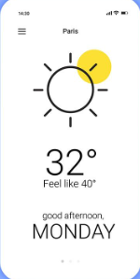
DEMO

Slide 10
Mobile Development
Ngày 25 tháng 05 năm 2022
Thank For Attention
Have a nice week

